Slide 1
Customers interact with the Bank via various channels such as Contact Centre & Video based Customer Identification Process Calls. Authentication measures of Caller ID / PIN / Security Questions / Device Signatures are often inadequate and intrusive.
Solution Expected:
For a sample voice clip, develop a voice signature for authentication with other voice samples & further develop the Voice signature as per repeated voice samples.
The following are the expectations from the prototype:
1. To Authenticate & continuously enhance Voice Signatures of Customers for interaction with the Bank via following channels:
Contact Centre
Mobile App
Video Customer Identification Process
2.Voice as additional factor of authentication
3.Response as a Percentage of model of Voice
Voice biometrics problem

Slide 2
Solution : use azure communication services
Build engaging communication experiences at scale
Azure Communication Services is a set of rich communication APIs, video APIs and SMS APIs for deploying your applications across any device, on any platform.
Reach customers anywhere with a fully managed platform
Deliver video, voice, chat, text messaging and telephony experiences anywhere your customers are—across your applications, websites and mobile platforms.
Scale with a global infrastructure used by Microsoft Teams
Build on a secure and compliant cloud

Slide 3
Solution : use azure communication services
Build custom app experiences connected to Microsoft Teams
Improve customer interactions by streamlining voice, video and chat experiences between people using your custom-built app and people on Microsoft Teams. As a bonus, VoIP and chat usage is only billed to your Azure resource when using Azure APIs and SDKs. Meaning usage for Microsoft Teams app users interacting with Azure Communication Services applications is free.*
Teams interoperability
Article
28/12/2021
5 minutes to read
15 contributors
Important
Bring your own identity (BYOI) interoperability for Teams meetings is now generally available to all Communication Services applications and Teams organizations.
Interoperability with Communication Services SDK with Teams identities is in public preview and available to Web-based applications.
Preview APIs and SDKs are provided without a service-level agreement and are not recommended for production workloads. Certain features might not be supported or might have constrained capabilities.

Slide 4
Solution : use azure communication services
The Communication Services UI Library provides customizable, production-ready UI components that can be easily added to these applications.
User identity models
Azure Communication Services supports two types of Teams interoperability depending on the identity of the user:
Bring your own identity (BYOI). You control user authentication and users of your custom applications don't need to have Azure Active Directory identities or Teams licenses. This model allows you to build custom applications for non-Teams users to connect and communicate with Teams users.
Teams identity. User authentication is controlled by Azure Active Directory and users of your custom application must have Teams licenses. This model allows you to build custom applications for Teams users to enable specialized workflows or experiences that are not possible with the existing Teams clients.
Applications can implement both authentication models and leave the choice of authentication up to the user

Slide 5
Solution : use azure communication services
Engage customers with API-enabled communication
Connect people across web and mobile apps. Add communication workflows to applications with flexible SDKs and APIs for common platforms and languages including iOS, Android, Web, .NET and JavaScript.
Scale up or down with a proven global platform
Deliver reliable enterprise-grade calling, chat and messaging capabilities from a global, low-latency network that automatically scales to meet your demands.
Enhance your communications with Azure services and tools
Azure services are designed to work together. For example, connect Azure Bot Service with Azure Communication Services telephony capabilities to improve your customer experience with intelligent voice assistants for handling customer calls. Tap into Azure Cognitive Services for translation and sentiment analysis of chat messages. Easily build SMS-based automation workflows connected to business-critical systems with Azure Event Grid and Logic Apps.

Slide 6
Solution : use azure communication services
Build conversational AI experiences for your customers
Develop enterprise-grade conversational AI experiences while maintaining control of your data. Build multilingual and multimodal bots for any scenario from sales to customer support and employee productivity.
Accelerate bot building with Bot Framework Composer
Start from a template and use a visual, open-source authoring canvas to extend and customise the conversation with code and prebuilt components.
Add natural language, speech and vision
Infuse your bot with the high-quality AI capabilities of Azure Cognitive Services. Enable your bot to interact with natural language and a recognisable, one-of-a-kind voice as unique as your brand.

Slide 7
Solution : use azure communication services
Deploy to popular channels with minimal code changes
Build once and deploy your bot to more than 13 channels to reach customers. Connect your bot to Interactive Voice Response (IVR) and digital channels, including your website, mobile apps, Microsoft Teams, Facebook Messenger and Slack.
Add natural language understanding to your bot
The ability to understand what your user means conversationally and contextually can be a difficult task, but can provide your bot a more natural conversation feel. Language Understanding (LUIS) is a cloud-based API service that enables you to do just that so that your bot can recognize the intent of user messages, allow for more natural language from your user, and better direct the conversation flow.
Prerequisites
A LUIS account.
A copy of the Core Bot sample in C#, JavaScript, Java, or Python.
Knowledge of bot basics and natural language processing.

Slide 8
Speech-to-text REST API v3.0
Copy models to other subscriptions if you want colleagues to have access to a model that you built, or if you want to deploy a model to more than one region.
Transcribe data from a container (bulk transcription) and provide multiple URLs for audio files.
Upload data from Azure storage accounts by using a shared access signature (SAS) URI.
Get logs for each endpoint if logs have been requested for that endpoint.
Request the manifest of the models that you create, to set up on-premises containers.
REST API v3.0 includes such features as:
Webhook notifications: All running processes of the service support webhook notifications. REST API v3.0 provides the calls to enable you to register your webhooks where notifications are sent.
Updating models behind endpoints
Model adaptation with multiple datasets: Adapt a model by using multiple dataset combinations of acoustic, language, and pronunciation data.
Bring your own storage: Use your own storage accounts for logs, transcription files, and other data.

Slide 9
Speech-to-text REST API v3.0
Next stages:
Customize acoustic models
Customize language models
Get familiar with batch transcription
What is the Speech SDK?
The Speech software development kit (SDK) exposes many of the Speech service capabilities you can use to develop speech-enabled applications. The Speech SDK is available in many programming languages and across all platforms.

Slide 10
Speech SDK
C isn't a supported programming language for the Speech SDK. Several supported programming languages, for example, C++, include C headers that are part of a common Application Binary Interface (ABI) layer. These ABI headers are not intended for direct use and are subject to change across versions.
Speech recognition, phrase list, intent, translation, and on-premises containers are available on the following platforms:
C++/Windows and Linux and macOS
C# (Framework and .NET Core)/Windows and UWP and Unity and Xamarin and Linux and macOS
Java (Jre and Android)
JavaScript (browser and NodeJS)
Python
Swift
Objective-C
Go (speech recognition only)

Slide 11
Speech SDK
Voice assistants
Voice assistants using the Speech SDK enable you to create natural, humanlike conversational interfaces for your applications and experiences.
Voice assistant support is available on the following platforms:
C++/Windows and Linux and macOS
C#/Windows
Java/Windows and Linux and macOS and Android (Speech Devices SDK)
Go
Keyword recognition
The concept of keyword recognition is supported in the Speech SDK.

Slide 12
continued.
Meeting scenarios
The Speech SDK is perfect for transcribing meeting scenarios, whether from a single device or multidevice conversation.
Conversation transcription
Conversation transcription enables real-time, and asynchronous, speech recognition, speaker identification, and sentence attribution to each speaker. This process is also known as diarization. It's perfect for transcribing in-person meetings with the ability to distinguish speakers.
Conversation transcription is available on the following platforms:
C++/Windows and Linux
C# (Framework and .NET Core)/Windows and UWP and Linux
Java/Windows and Linux and Android
Multidevice conversation

Slide 13
continued.
Custom/agent scenarios
The Speech SDK can be used for transcribing call center scenarios, where telephony data is generated.
Call center transcription
Call center transcription is a common scenario for speech-to-text for transcribing large volumes of telephony data that might come from various systems, such as interactive voice response. T
Call center transcription is available through the batch Speech service via its REST API and can be used in any situation.
Codec-compressed audio input
Several of the Speech SDK programming languages support codec-compressed audio input streams. For more information, see Use compressed audio input formats.
Codec-compressed audio input is available on the following platforms:
C++/Linux
C#/Linux
Java/Linux, Android, and iOS

Slide 14
continued.
Use speaker recognition . Speaker recognition can help determine who is speaking in an audio clip. The service can verify and identify speakers by their unique voice characteristics, by using voice biometry.
You provide audio training data for a single speaker, which creates an enrollment profile based on the unique characteristics of the speaker's voice. You can then cross-check audio voice samples against this profile to verify that the speaker is the same person (speaker verification). You can also cross-check audio voice samples against a group of enrolled speaker profiles to see if it matches any profile in the group (speaker identification).
Microsoft limits access to speaker recognition. You can apply for access through the Azure Cognitive Services speaker recognition limited access review

Slide 15
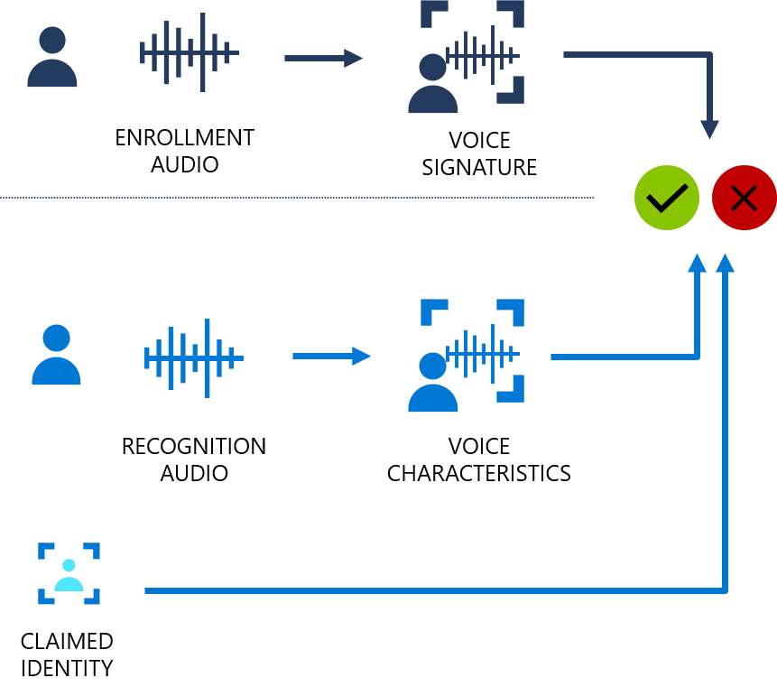
Speaker verification
Speaker verification streamlines the process of verifying an enrolled speaker identity with either passphrases or free-form voice input. For example, you can use it for customer identity verification in call centers or contactless facility access.

Slide 16
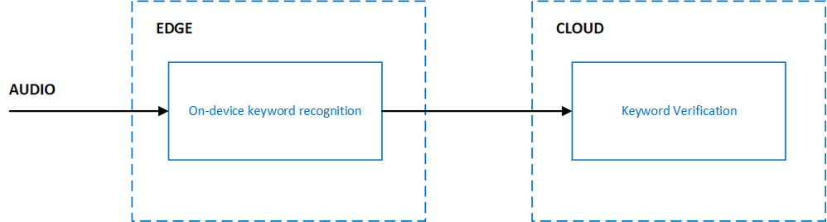
Add voice activation to your product with Custom Keyword

Slide 17
Continued
Architecture of cloud computing as relevant here
Cloud services are based upon five principal characteristics that demonstrate their relation to, and differences from, traditional computing approaches (CSA Security Guidance, 2009). These characteristics are: (i) abstraction of infrastructure, (ii) resource democratization, (iii) service oriented architecture, (iv) elasticity/dynamism, (v) utility model of consumption and allocation.

Slide 18
Cloud computing architecture
Cloud Service Delivery Models Three archetypal models and the derivative combinations thereof generally describe cloud service delivery. The three individual models are often referred to as the “SPI MODEL”, where “SPI” refers to Software, Platform and Infrastructure (as a service) respectively (CSA Security Guidance, 2009). Software as a Service (SaaS): The capability provided to the consumer is to use the provider’s applications running on a cloud infrastructure and accessible from various client devices through a thin client interface such as web browser. In other words, in this model, a complete application is offered to the customer as a service on demand

Slide 19
Continued
Platform as a Service (PaaS): In this model, a layer of software or development environment is encapsulated and offered as a service, upon which other higher levels of service are built. The customer has the freedom to build his own applications, which run on the provider’s infrastructure. Hence, a capability is provided to the customer to deploy onto the cloud infrastructure customer-created applications using programming languages and tools supported by the provider (e.g., Java, Python, .Net etc.).

Slide 20
Continued
Infrastructure as a Service (IaaS): This model provides basic storage and computing capabilities as standardized services over the network. Servers, storage systems, networking equipment, data center space etc. are pooled and made available to handle workloads. The capability provided to the customer is to rent processing, storage, networks, and other fundamental computing resources where the customer is able to deploy and run arbitrary software, which can include operating systems and applications

Slide 21
Continued
Cloud Service Deployment and Consumption Models Regardless of the delivery model utilized (SaaS, PaaS, IaaS) there are four primary ways in which cloud services are deployed (CSA Security Guidance, 2009). Cloud integrators can play a vital role in determining the right cloud path for a specific organization. Public cloud: Public clouds are provided by a designated service provider and may offer either a singletenant (dedicated) or multi-tenant (shared) operating environment with all the benefits and functionality of elasticity and the accountability/utility model of cloud. The physical infrastructure is generally owned by and managed by the designated service provider and located within the provider’s data centers (offpremises). All customers share the same infrastructure pool with limited configuration, security protections, and availability variances. One of the advantages of a public cloud is that they may be larger than an enterprise cloud, and hence they provide the ability to scale seamlessly on demand.

Slide 22
Continued
Private cloud: Private clouds are provided by an organization or their designated services and offer a single-tenant (dedicated) operating environment with all the benefits and functionality of elasticity and accountability/utility model of cloud. The private clouds aim to address concerns on data security and offer greater control, which is typically lacking in a public cloud. There are two variants of private clouds: (i) on-premise private clouds and (ii) externally hosted private clouds. The on-premise private clouds, also known as internal clouds are hosted within one’s own data center. This model provides a more standardized process and protection, but is limited in aspects of size and scalability. IT departments would also need to incur the capital and operational costs for the physical resources. This is best suited for applications which require complete control and configurability of the infrastructure and security. As the name implies, the externally hosted private clouds are hosted externally with a cloud provider in which the provider

Slide 23
Continued
Hybrid cloud: Hybrid clouds are a combination of public and private cloud offerings that allow for transitive information exchange and possibly application compatibility and portability across disparate cloud service offerings and providers utilizing standard or proprietary methodologies regardless of ownership or location. With a hybrid cloud, service providers can utilize third party cloud providers in a full or partial manner, thereby increasing the flexibility of computing. The hybrid cloud model is capable of providing on-demand, externally provisioned scale. The ability to augment a private cloud with the resources of a public cloud can be used to manage any unexpected surges in workload.
Managed cloud

